Slide 1
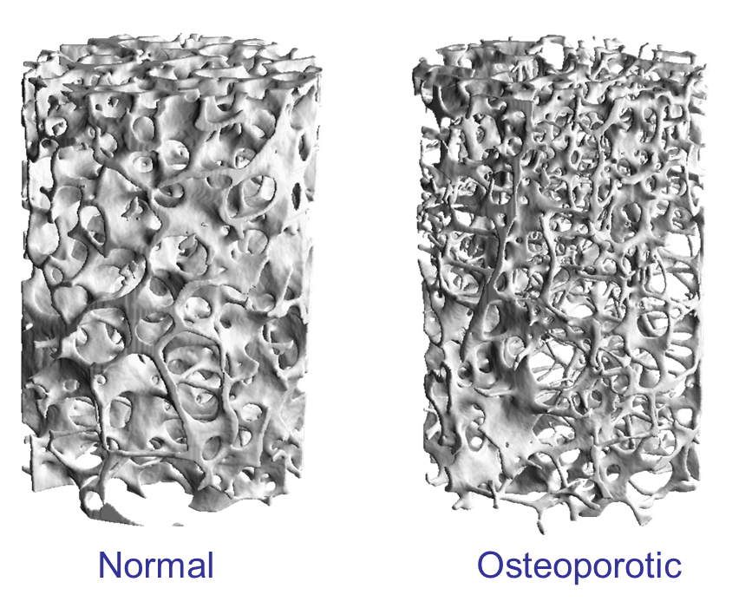
Osteoporosis treatment
How to choose the right medication for osteoporosis
Dr. Husham Aldaoseri

Slide 2
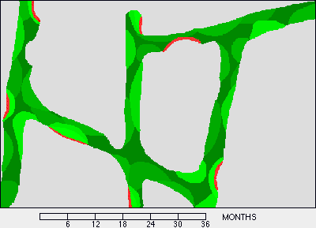

Definition of Osteoporosis
“Osteoporosis is defined as a skeletal disorder characterized by a compromised bone strength predisposing a person to an increase risk of fracture.”
NIH Consensus Development Panel on Osteoporosis
Prevention, Diagnosis, and Therapy. JAMA. 2001;285:785-795

Slide 3
BONE STRENGTH
BONE MINERAL
DENSITY
BONE QUALITY
Bone
architechture
Gram of
mineral
per area
Bone
turnover
Bone
size &
geometry

Slide 4
Defining The T-score
OSTEOPOROSIS
LOW BONE MASS (“OSTEOPENIA”)
NORMAL BONE MASS
T-score
-4.0 -3.5 -3.0 -2.5 -2.0 -1.5 -1.0 -.5 0 +.5 +1

Slide 5
Fractures in Women Are Common:
Incidence of Chronic Diseases
2.0
1,500,000
1.5
1.0
Annual Incidence, million
345,000
373,000
0.5
250,000
211,240
0
Fracture¹
Hip fracture¹
Heart attack²
Stroke²
Breast cancer³
Women with osteoporosis
All women
Risk of osteoporotic fracture in 1 year is greater than
combined risk of heart attack, stroke, and breast cancer.
1. Riggs BL, Melton LJ III. Bone. 1995;17(suppl):505S–511S.
2. American Stroke Association. Heart disease and stroke statistics––2005 update. Available at: http://www.americanheart.org. Accessed August 24, 2005.
3. American Cancer Society. Cancer facts & figures; 2005. Available at: http://www.cancer.org. Accessed August 24, 2005.
Notes:
Fractures in Women Are Common: Incidence of Chronic Diseases
This slide demonstrates that the incidence of new cases of osteoporotic fracture in women each year is far greater than the incidence of heart attack, stroke, and breast cancer combined.^{1–3} Hip fracture incidence alone exceeds that of breast cancer.¹
This information, with the information on the previous slide, further emphasizes that osteoporosis should be considered a major health concern among postmenopausal women in the United States. The point is not to suggest that osteoporosis is more important than the other diseases but that it should be managed as routinely as are the other diseases.
References:
1. Riggs BL, Melton LJ III. The worldwide problem of osteoporosis: insights afforded by epidemiology. Bone.
1995;17(suppl):505S–511S.
2. American Stroke Association. Heart disease and stroke statistics––2005 update. Available at:
http://www.americanheart.org/downloadable/heart/1105390918119HDSStats2005Update.pdf. Accessed
August 24, 2005.
3. American Cancer Society. Cancer facts & figures: 2005. Available at:
http://www.cancer.org/downloads/STT/CAFF2005f4PWSecured.pdf. Accessed August 24, 2005.

Slide 7
Bone Metabolism:
A Balance Between Osteoblasts and Osteoclasts

Slide 9
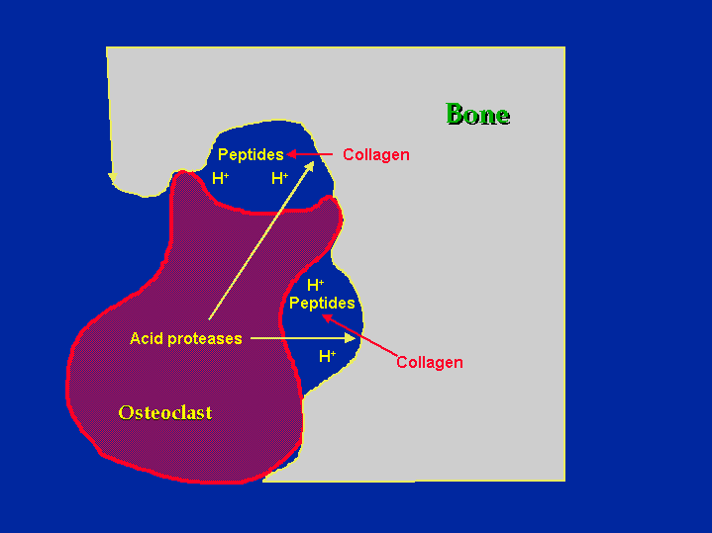
Osteoclasts Resorb Bone
Howship’s Lacunae
Carbonic Anhydrase II
Tartate Resistant Acid Phosphatase
Cathepsin K

Slide 10

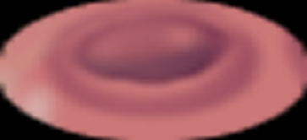
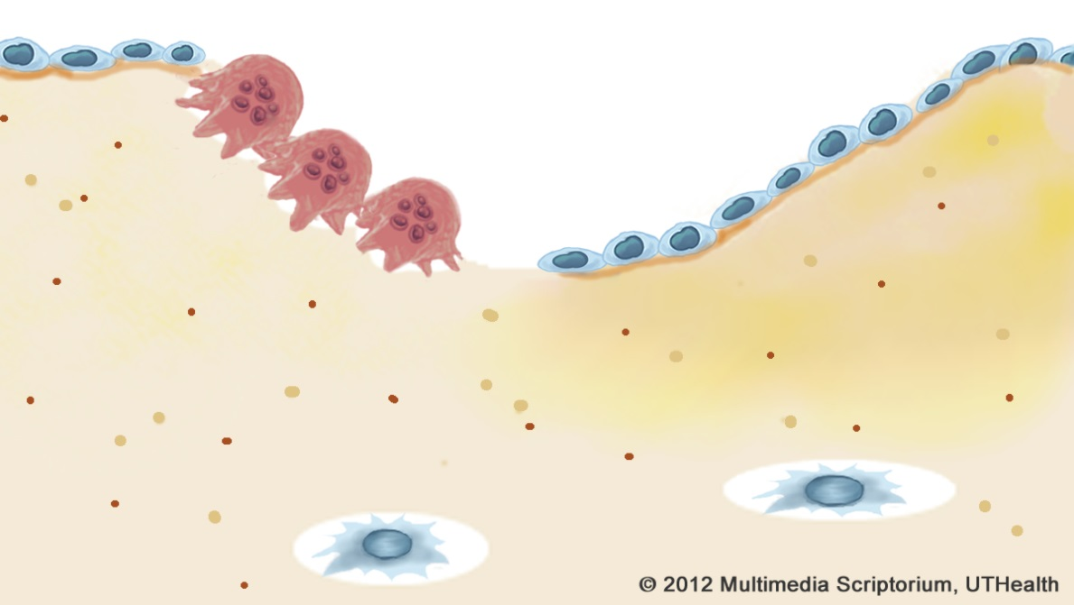
Bone Marrow Progenitors
Osteoblast Precursor
Osteoclast Precursor
Glucocorticoids
_
_
Estrogen Calcitonin
Estrogen Androgens
GH/IGF-1
+
+
Thyroxine Vitamin A
1,25 OHD
PTH
Osteoblast
New Bone Formation
Osteoclast
Bone Resorption
Osteocyte

Slide 11
Evaluation of Osteoporosis
Comprehensive history and physical examination
Baseline labs:
CBC+ESR
Serum chemistry studies( Electrolytes, Ca, Phos, total protein, albumin, liver enzymes, ALP, Cr)
Urinary calcium excretion
AACE Osteoporosis Guidelines

Slide 12
Other Labs for Secondary Osteoporosis Workup
Serum thyrotropin
ESR
Serum PTH
Serum 25-hydroxyvit D
Urinary free cortisol and other tests for adrenal hypersecrtion
Serum or urine protein electrophoresis
Bone marrow aspiration and biopsy
Acid- base studies
Biochemical markers for bone turnover (Bone specific ALP, urine and serum collagen crosslinks)
Serum tryptase, urine N-methylhistamine or other tests for mastocytosis
AACE Osteoporosis Guidelines, Endo Prac.2003;9(6)545-564.

Slide 13
Indications for Treatment of Postmenopausal Osteoporosis
National Osteoporosis Foundation:
T score below -2.0 with no risk factors
T score below -1.5 with one or more risk factors
Prior vertebral or hip fracture
American Association of Clinical Endocrinology
T score < - 2.5
T score < -1.5 and risk factors
Low trauma fracture and low BMD
NOF:.
Hodgson SF et al. Endocr Pract 2003;9:544-64.

Slide 14
Consider FDA-approved medical therapies based on the following:
Vertebral fracture (clinical or asymptomatic) or hip fracture
Hip DXA (femoral neck or total hip) or lumbar spine T-score ≤−2.5
Low bone mass (osteopenia) and a 10-year probability of a hip fracture ≥3 % or 10-year probability of any major osteoporosis-related fracture ≥20 %

Slide 15
Osteoporosis
Therapeutic Options
Pharmacological Therapy
  Low risk (0-10%)
    No drug treatment
  Moderate risk (10-20%)
    Consider treatment – discuss with patient
  High risk (>20%)
  High risk: FRAX hip fracture score >3%
  High risk: > 50y.o. + Hx of hip or spine fragility fracture
  High risk: > 50y.o. + Hx of multiple fractures
    Treat

Slide 16
Guidelines for Follow-up BMD Measurements
Baseline T scores > -1.0, no new risk factors: repeat in 5 - 10 years.
Baseline T scores < -1.0, not on therapy, with ongoing risk factors: repeat in 2-4 years.
Baseline T scores < -1.5, monitoring therapy: repeat in 5 years.
Aggressive disease progression suspected, based on clinical situation: may repeat in 6-12 months.
Note: The Z-score, and not the T-score, should be used in premenopausal women, men <50 years, and in children
AACE Osteoporosis Guidelines, Endo Prac.2003;9(6)545-564.

Slide 17
Goals of Treatment
Because fractures are the main cause of the morbidity and mortality associated with “osteoporosis”, the goal of therapies should be directed towards prevention of a fracture.

Slide 18
Nonpharmocologic Treatment
Daily recommendations of calcium:
Women ≥51 and Men >70: 1200 mg/day
Women 19-50 years, Men 50-70 years: 1000 mg/day
Daily recommendations for vitamin D
Adults <50: 400-800 IU daily
Adults ≥50: 800-1000 IU daily (NOF)
Obtained from a combination of dairy products, other calcium-rich foods, sunlight,vitamin D-fortified milk, cereals, egg yolks, fatty fish, and liver.
Treat vitamin D deficiency
Maintain serum 25-hydroxyvitamin D (25[OH]D)level to ≥30 ng/ml
Treat with 50,000 IU once weekly for 8-12 weeks
Follow with maintenance dose of 1500-2000 IU daily
Safe upper limit of vitamin D intake is 4000 IU per day

Slide 19
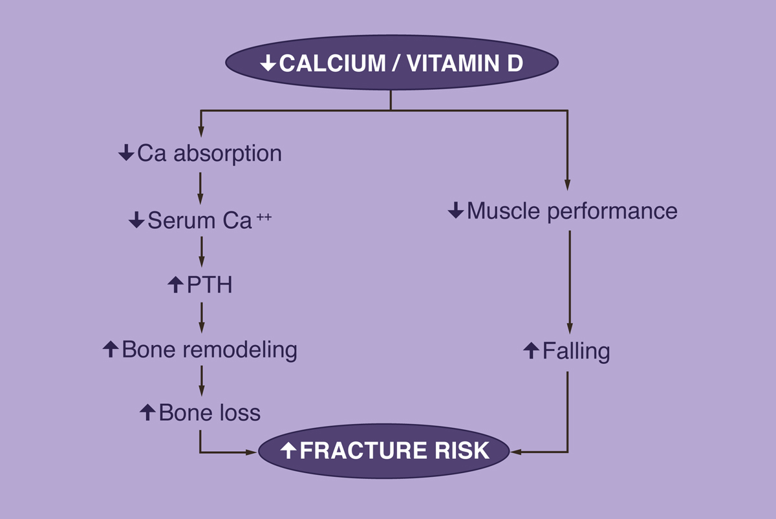
Vitamin D is required to prevent bone loss and fractures
Modified from Dawson-Hughes BoneKEy 2(12):39-41.

Slide 20
Changes in BMD with Calcium + Vitamin D
Chapuy et al.
Dawson-Hughes et al.
Site
Placebo
Ca/D
Site
Placebo
Ca/D
Fem Neck
+1.8
+2.9*
Fem Neck
-0.70
+0.50*
Total Hip
-4.6
+2.7*
Spine (L2-4)
+1.22
+2.12*
Trochanter
-6.4
-1.0*
Total body
-1.09
+0.06*
*p < 0.05
*p < 0.05
Chapuy et al, N Engl J Med 1992;327:1637, with permission, Copyright © 1992 Massachusetts Medical Society. All rights reserved.
Dawson-Hughes et al, N Engl J Med 1997;337:670, with permission, Copyright © 1997 Massachusetts Medical Society. All rights reserved.
Notes:
20
The changes in BMD that occur with treatment with calcium and vitamin D are small. This slide summarizes the changes in BMD in the 2 studies shown in the previous slide. In the panel on the right, changes in BMD with vitamin D + calcium are modest at best, but still resulted in a substantial and significant reduction in fracture risk. There is therefore speculation that treatment with calcium and vitamin D reduce the incidence of fractures by other means as well, as illustrated in the next slide.

Slide 21
Vitamin D Prevents Falls: Meta-analysis
Source
Odds Ratio
Favors
Vitamin D
Favors
Control
(95% Cl)
Pfeifer et al, 2000
0.47 (0.20-1.10)
Bischoff et al, 2003
0.68 (0.30-1.54)
Gallagher et at, 2001
0.53 (0.32-0.88)
Dukas et al, 2004
0.69 (0.41-1.16)
Graafmans et al, 1996
0.91 (0.59-1.40)
Pooled (Uncorrected)
0.69 (0.53-0.88)
0.1
0.5
1.0
5.0
10.0
Odds Ratio
Redrawn from Bischoff-Ferrari H et al JAMA. 2004 Apr 28;291(16):1999-2006, with permission, Copyright © 2004 American Medical Association. All rights reserved.
Notes:
21
In addition to modest increases in BMD, treatment with calcium and vitamin D reduces the likelihood of falls, according to this metaanalysis of five randomized clinical trials. This effect of vitamin D therapy may have to do with improved muscle function and strength.

Slide 22
Calcitriol
This synthetic vitamin D analogue, which promotes calcium absorption, has been approved by the FDA for managing hypocalcemia and metabolic bone disease in renal dialysis patients. It is also approved for use in hypoparathyroidism, both surgical and idiopathic, and pseudohypoparathyroidism. No reliable data demonstrate a reduction of risk for osteoporotic fracture.

Slide 23
Engage in regular weight-based and muscle-strengthening exercise
Reduces risk of falls and fractures by improving agility, strength, posture, and balance
Fall Prevention
Home safety assessment and modification
Gradual withdrawal of psychotropic medication, if possible
Correction of visual impairments
Consider hip protectors in those with high risk of falling

Slide 24
Cessation of tobacco use and avoidance of excessive alcohol intake
Tobacco use is detrimental to skeleton and overall health; address cessation at every visit
Excess alcohol (>2 drinks/day for women, >3 drinks/day for men) may be detrimental to bone health; increases fall risk (NOF)
Limit alcohol use to no more than 1 drink/day for women, no more than 2 drinks/day for men

Slide 25
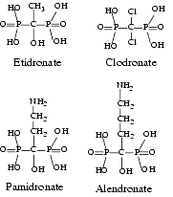
Treating Osteoporosis
Estrogen therapy
  Reduces RANKL expression
Bisphosphonates
  Induce osteoclast apoptosis
Estrogen receptor drugs Raloxifene
PTH like drugs
Calcitonin
Anti-RANKL

Slide 26
Rational Prescribing
Type of harm
Quantity of harm
Quality of evidence
Time to harm
Type of benefit
Quantity of benefit
Quality of evidence
Time to benefit
1. Efficacy
2. Toxicity
3. & 4. Cost & Convenience

Slide 27
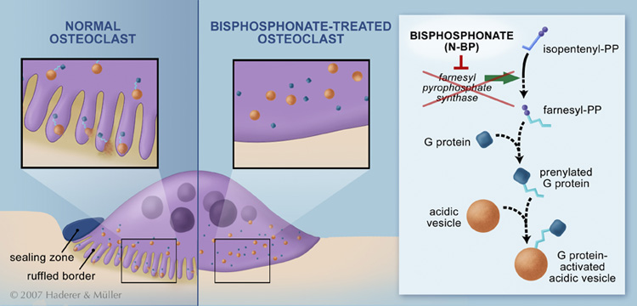
Bisphosphonates
Inhibit Bone Resorption by Preventing Formation of the Ruffled Border

Slide 28
There are seven bisphosphonates on the market:
  Etidronate
  Clodronate
  Tiludronate
  Pamidronate
  Alendronate
  Risedronate
  Ibandronate
  Zoledronic Acid
  Bisphosphonates (etidronate, pamidronate, tiludronate):
  These medications vary chemically from alendronate, ibandronate,
  risedronate, and zoledronic acid but are in the same drug class. At this time, none is approved for prevention or treatment of osteoporosis.
  Most of these medications are currently approved for other conditions (e.g., Paget’s disease, hypercalcemia of malignancy, myositis ossificans).

Slide 29
Agent | Toxicity | Cost / Convenience
Alendronate (Fosamax®) (Fosavance®) | Esophagitis Adynamic bone disease Osteonecrosis of the jaw Hypocalcemia | 10mg po daily or 70mg po weekly 70mg+(2800iu or 5600iu Vit D) po weekly ODB covered Fasting, ++ H2O admin; upright
Risedronate (Actonel®) (Actonel DR®) | ~ same | 5mg po QD / 35mg po qWk / 150mg po qMo [Fasting, ++ H2O admin; upright] 35mg DR formulation – w/ food
Zoledronate (Aclasta®) | ~ same (newer, less known) (minus esophagitis) (plus ?AFib) infusion reactions, myalgias | 5mg IV once yearly
Denosumab (Prolia®) | Unknown - too new ?malignancy, ?infection ?CV or ?ocular effects Derm events ONJ Hypocalcemia | 60mg sc q6months

Slide 30
Alendronate reduces the incidence of spine and hip fractures by about 50 % over 3 years in patients with a prior vertebral fracture or in patients who have osteoporosis at the hip site . It reduces the incidence of vertebral fractures by 48 % over 3 years in patients without a prior vertebral fracture.
Risedronate reduces the incidence of vertebral fractures by 41 to 49 % and nonvertebral fractures by 36 % over 3 years, with significant risk reduction occurring within 1 year of treatment in patients with a prior vertebral fracture.

Slide 31
Ibandronate reduces the incidence of vertebral fractures by about 50 % over 3 years, but reduction in risk of nonvertebral fracture with ibandronate has not been documented.
Zoledronic acid reduces the incidence of vertebral fractures by 70 % (with significant reduction at 1 year), hip fractures by 41 %, and nonvertebral fractures by 25 % over 3 years in patients with osteoporosis defined by prevalent vertebral fractures and osteoporosis by BMD of the hip.

Slide 32
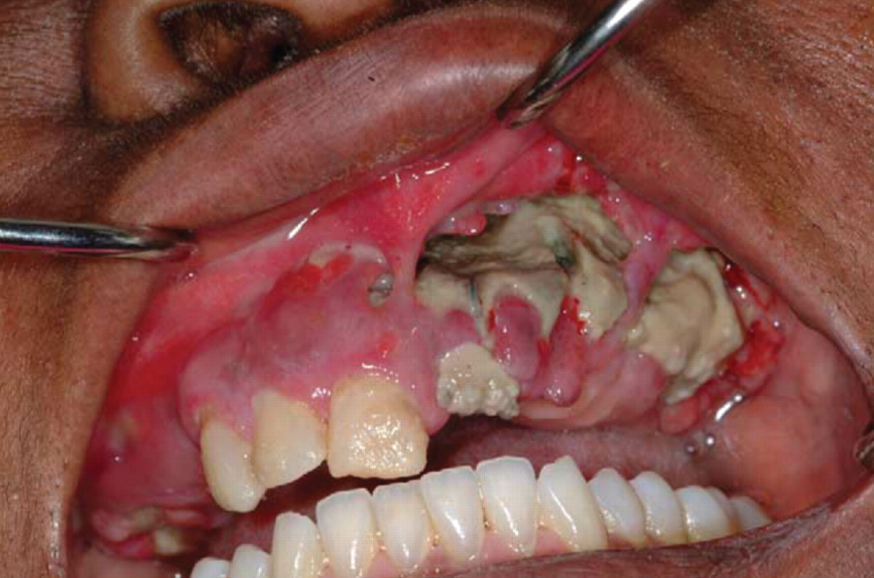
Osteonecrosis of the jaw.
BUENCAMINO M C A et al. Cleveland Clinic Journal of Medicine 2009;76:467-475
Notes:
Osteonecrosis of the jaw. REPRODUCED FROM RUGGIERO SL, MEHROTRA H, ROSENBERG TJ, ENGROFF SL. OSTEONECROSIS OF THE JAWS ASSOCIATED WITH THE USE OF BISPHOSPHONATES: A REVIEW OF 63 CASES. J ORAL MAXILLOFACIAL SURG 2004; 62:527–534, WITH PERMISSION FROM ELSEVIER. WWW.SCIENCEDIRECT.COM/SCIENCE/JOURNAL/02782391.

Slide 33
Change bisphosphonate to raloxifene or calcitonin ( however studies with these medications did not demonstrate reduction in nonvertebral fractures).
Offer patient PTH (1-34): Teriparatide

Slide 34
PTH (1-34): Teriparatide
First anabolic agent approved by the FDA for the treatment of osteoporosis.
Dose: 20 mcg/day SQ
Indications:
  Postmenopausal women with severe osteoporosis.
  Men with primary or hypogonadal osteoporosis.
  Patients with glucocorticoid-induced osteoporosis

Slide 35
PTH
Reduced vertebral fracture 65% and nonvertebral fractures by more than 53% .
Significantly increased BMD after 19 months
8.6% at lumbar spine
3.7% at the trochanter
Black Box Warning: osteosarcoma.
Duration of therapy: should not exceed 2 years.
Therapy with bisphosphonate should be discontinued - may blunt the anabolic effect
Therapy with reabsorptive agent should be restarted after PTH stopped.
Neer RM et al. ,NEJM 2001;344:1434-1441.

Slide 36
Denosumab (Prolia)
(Anti-resorptive agent)
Approved June 1, 2010
Made by Amgen
A fully human monoclonal antibody that binds with high affinity to, and inhibits the activity of, human RANK ligand, a key mediator of osteoclast activity

Slide 37




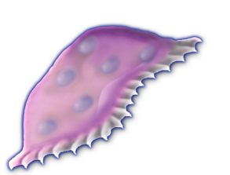

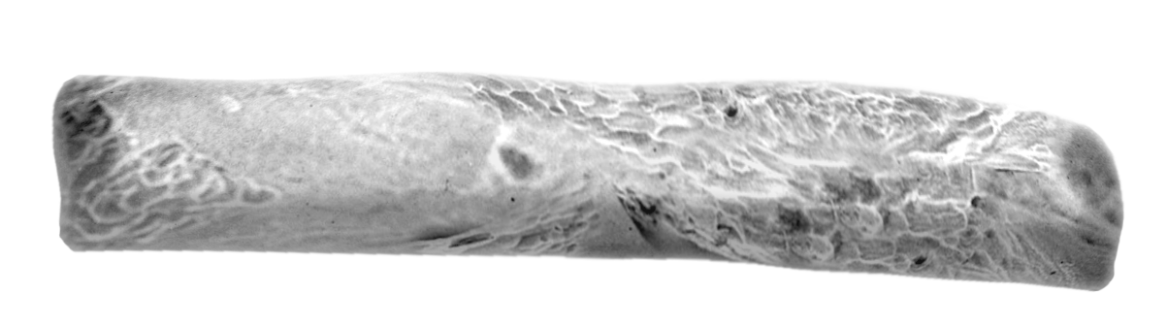
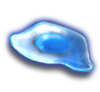
RANKL Stimulates Bone Resorption
RANK Ligand Is Essential for Osteoclast Formation, Function, and Survival
RANKL
CFU-M
RANK
Pre-Fusion
Osteoclast
Growth Factors Hormones
Cytokines
Multinucleated
Osteoclast
Activated
Osteoclast
Osteoblast
Lineage
CFU-M = colony forming unit macrophage
Bone
Adapted from Boyle WJ, et al. Nature. 2003;423:337-342.
Notes:
37
Receptor Activator of Nuclear Factor-kappa B (RANK) Ligand is essential for osteoclast formation, function, and survival.¹⁻⁵
In the presence of low levels of macrophage colony-stimulating factor (M-CSF), RANK Ligand is essential for osteoclast formation, function, and survival.¹⁻⁵
Osteoclasts are the cells responsible for resorbing bone.
Many different factors (e.g., PTH, TNF, IL-1) can lead to bone loss. These stimulate the expression of RANK Ligand by cells of the osteoblast lineage and other cells (e.g., activated T cells).^{2,5}
The RANK Ligand polypeptide is a type II transmembrane protein found on the surface of expressing cells as well as in a proteolytically released (cleaved) soluble form.³
RANK Ligand is expressed (both in a transmembrane and soluble form) from the osteoblast lineage cells.⁴
In addition, RANK Ligand is expressed in various cell types including, but not limited to: lymphoid cells,⁶ basal epithelial, luminal epithelial and stromal cells from normal prostate⁷ and non-malignant breast tissue,⁸ including mammary epithelial cells,⁹ tumor cells including breast cancer cells,⁸ prostate cancer cells and subsequent bone metastases;⁷ dendritic cells, activated T-cells and B-cells,¹⁰ osteoblasts⁵ and osteoclasts, mesenchymal cells, proliferative chondrocytes, early osteocytes and periosteal cells; synovial tissue,¹¹ cardiomyocytes, vascular smooth muscle cells, endothelial cells,¹² and the GI tract.¹³ The clinical significance of these findings is unknown.
RANK Ligand subsequently binds to its receptor, RANK, on immature and mature osteoclasts, which leads to maturation of pre-fusion osteoclasts to multinucleated osteoclasts and finally to activated osteoclasts.⁵
RANK is expressed on osteoclasts and osteoclast progenitors. In addition, RANK has been observed on cartilage cells (chondrocytes), mammary gland epithelial cells, and trophoblast cells.^{5,6,7}
1. Yasuda H, et al. Proc Natl Acad Sci USA. 1998;95:3597-3602.
2. Fuller K, et al. J Exp Med. 1998;188:997-1001.
3. Lacey DL, et al. Cell. 1998;93:165-176.
4. Lacey DL, et al. Am J Pathol. 2000;157:435-448.
5. Boyle WJ, et al. Nature. 2003;423:337-342.
6. Kong Y-Y, et al. Nature. 1999;397:315-323.
7. Brown JM, et al. Urology. 2001;57:611-616.
8. Van Poznak C, et al. J Clin Pathol. 2006;59:56-63.
9. Fata JE, et al. Cell. 2000:103:41-50.
10. Anderson DM, et al. Nature. 1997;390:175-179.
11. Crotti TN, et al. Ann Rheum Dis. 2002;61:1047-1054.
12. Ueland T, et al. Circulation. 2005;111:2461-2468.
13. Moschen AR, et al. Gut. 2005;54:479-487.
14. Hsu H, et al. Proc Natl Acad Sci USA. 1999:96:3540-3545.

Slide 38
Denosumab, Prolia® Denosumab for
Treatment of osteoporosis in postmenopausal women at high risk of fracture.
Denosumab reduces the incidence of vertebral fractures by about 68 %, hip fractures by about 40 %, and nonvertebral fractures by about 20 % over 3 years .
Denosumab is also indicated to increase bone mass in men at high risk of fracture.
Treat bone loss in women with breast cancer on aromatase inhibitor therapies.
Treat bone loss in men receiving gonadotropin-reducing hormone treatment for prostate cancer who are at high risk for
fracture

Slide 39


Denosumab Mechanism of Action
RANKL
RANK
OPG
CFU-M
Dmab
Pre-Fusion
Osteoclast
Growth Factors Hormones
Cytokines
Multinucleated
Osteoclast
RANKL
Osteoclast
Osteoblast
Lineage
CFU-M = colony forming unit macrophage
Bone
Notes:
39
Denosumab is an investigational, fully human monoclonal antibody that binds with high affinity to, and inhibits the activity of human RANK (receptor activator of nuclear factor kappa B) ligand, a key mediator of osteoclast activity¹.
RANK Ligand is an essential pathway in the formation, activation, and survival of osteoclasts^{1,2}.
Denosumab does not bind to other TNF receptors.¹
The pharmacokinetics (SC administration) of denosumab in postmenopausal women were nonlinear with dose.
The serum profiles were characterized by three distinct phases: 1) a prolonged absorption phase: maximum serum concentrations increased disproportionately greater (2.6-fold) than the increase in dose and were observed between 5 and 21 days after administration; 2) a prolonged β-phase: half-lives that increased with dose to a maximum of 32 days; and 3) a more rapid terminal phase observed at concentrations <1,000 ng/mL with a half-life that increased from 5 to 10 days as dose increased from 0.01 to 3.0 mg/kg. The mean serum residence time increased with dose from 12 to 46 days.¹
1. Bekker PJ, et al. A single-dose placebo-controlled study of AMG-162, a fully human monoclonal antibody to RANKL, in postmenopausal women. J Bone Miner Res. 2004;19:1059-1066.
2. Boyle WJ, et al. Osteoclast differentiation and activation. Nature. 2003;423:337-342.
3. Peterson MC, et al. AMG 162 maintains serum concentrations for up to 9 months following a single subcutaneous dose in healthy postmenopausal women. J. Bone Miner. Res. 2003; 18(Suppl 2):S166. Abstract SA393 and poster.

Slide 40
Duration of Therapy
Usually sequential, not combination
  Very rarely combo therapy for short term if very high risk
  Benefits disappear rapidly after discontinuation
  Benefits beyond 5 years not well described
  Rare safety concerns more common after 5 years
Little guidance on when to stop or restart
  Reassess after 5 – 7 years and ?
  Alendronate – t ½ 10 years: 1 - 2 yr off then R/A
  Risedronate – t ½ 3 weeks: 6 – 12 mo off then R/A
  Denosumab – t ½ 4 weeks: 6 – 12 mo off then R/A

Slide 41
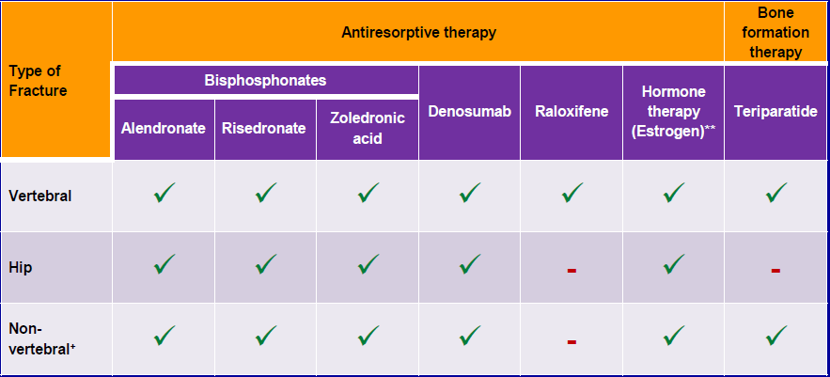
Pharmacological Therapy
1st Line Therapy w/ Evidence for Fracture
Prevention in Postmenopausal Women
How to Choose?
William D. Leslie, MD MSc FRCPC, Umanitoba. Module 5 - Speaking of Bones Osteoporosis For Health Professionals: Fracture Risk Assessment . http://www.osteoporosis.ca/wp-content/uploads/Module-5-Fracture-Risk-Assessment-ppt.pdf

Slide 42
Pharmacological Therapy
1st Line Therapy w/ Evidence for Fracture
Prevention in Postmenopausal Women
How to Choose?
William D. Leslie, MD MSc FRCPC, Umanitoba. Module 5 - Speaking of Bones Osteoporosis For Health Professionals: Fracture Risk Assessment . http://www.osteoporosis.ca/wp-content/uploads/Module-5-Fracture-Risk-Assessment-ppt.pdf

Slide 43
New and Emerging Treatments
Abaloparatide (recombinant parathyroid hormone-related peptide 1-34) is a newly approved injected medication for severe osteoporosis. Parathyroid hormone-related peptide (PTHrP) shares homology with PTH, but stimulates less bone catabolism and is less potent at increasing serum calcium.

Slide 44
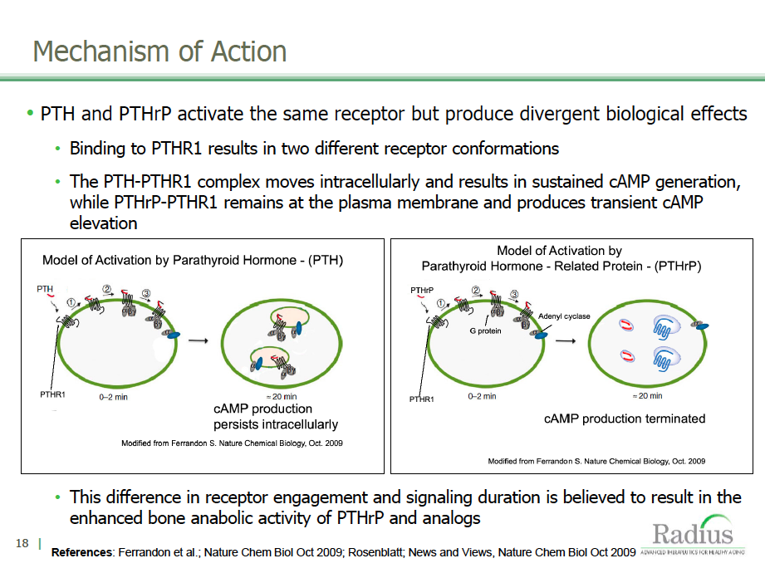
Abaloparatide: PTHrP-based Mechanism of Action
Notes:
Abaloparatide is a novel synthetic analogue of human PTHrP, selected to achieve potent and rapid anabolic activity, limited effects on bone resorption compared to PTH and room temperature stability.

Slide 45
Romosozumab increased a marker of bone formation and decreased a marker of bone resorption
Placebo SC (n = 14)
0.1 mg/kg SC (n = 6)
P1NP
sCTx
0.3 mg/kg SC (n = 6)
1 mg/kg SC (n = 9)
3 mg/kg SC (n = 6)
200
60
5 mg/kg SC (n = 9)
10 mg/kg
10 mg/kg SC (n = 6)
160
40
5 mg/kg
20
120
0
Mean Percent Change From Baseline
80
3 mg/kg
-20
40
-40
0
-60
-40
-80
0
8
15
22
29
36
43
50
57
64
71
78
85
0
8
15
22
29
36
43
50
57
64
71
78
85
Time (Day)
Time (Day)
Adapted from Padhi D, et al. J Bone Miner Res. 2010; DOI 10.1002/jbmr.173.
Notes:
45
Padhi JBMR 2010
20 Fig2A&D
8-3
8-3

Slide 46
Bone mineral density – Year 1
Lumbar Spine
Total Hip
15
6
11.3%
4.1%
4
10
Percent Change from Baseline
2
5
0
0
-2
0
3
6
9
12
18
24
0
3
6
9
12
18
24
Month
Month
Data are means and 95% CIs
ALN
Placebo
Romosozumab 210 mg QM
TPTD
McClung et al. NEJM 2014;370:5.

Slide 47
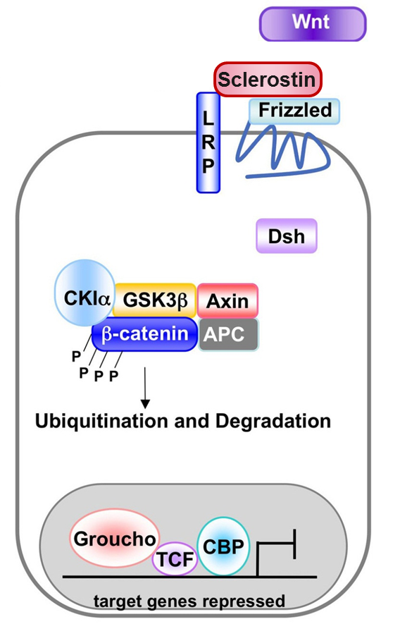
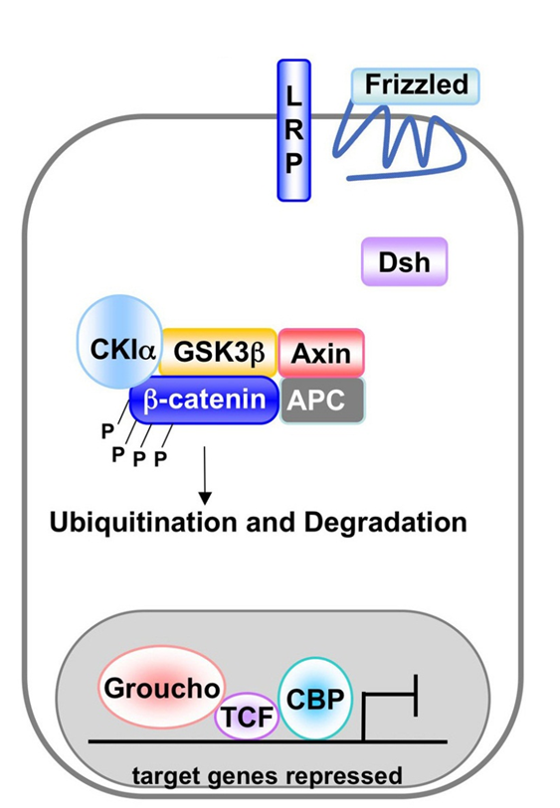
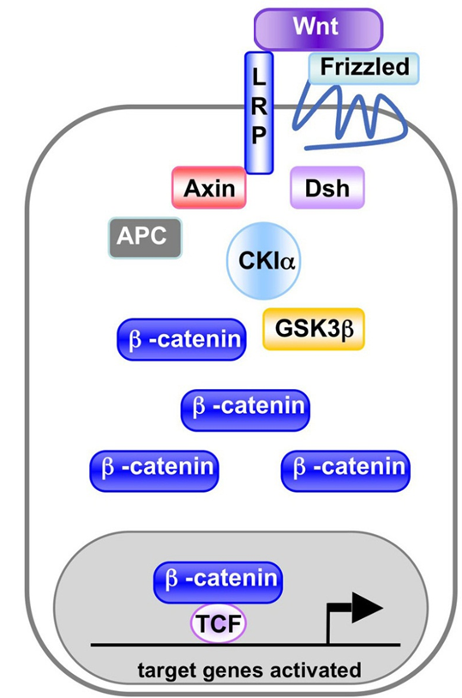
What does it do?
No bone formation
Bone formation
No bone formation
Modified from http://www.wormbook.org/chapters/www_wntsignaling/wntfig1.jpg

Slide 48
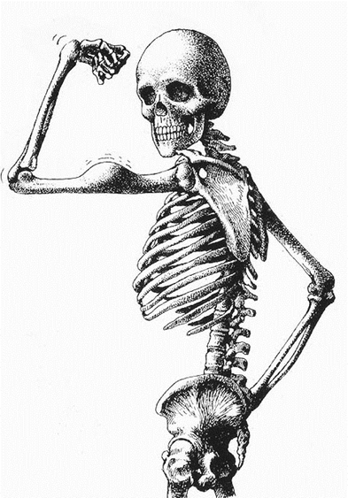
Thank you

